Slide 1
VR Pets
Third Update

Slide 2
Last Time…
Still Deciding on Hardware
No Environment/Framework/Interactivity
Default Model/Animations Used
No Interface

Slide 3
We Met over break and…

Slide 4
Well…
What are we using?
Oculus Rift
Oculus Touch
Unity 2018.3.1f1
Blender

Slide 5
Section Formats:
What was done?
What got done over break?
Milestones?
What do we do next?

Slide 6
Environment:
Before Break, we had basic Unity project.
We created the environment.
See next slide
Only really needs finishing touches.

Slide 7
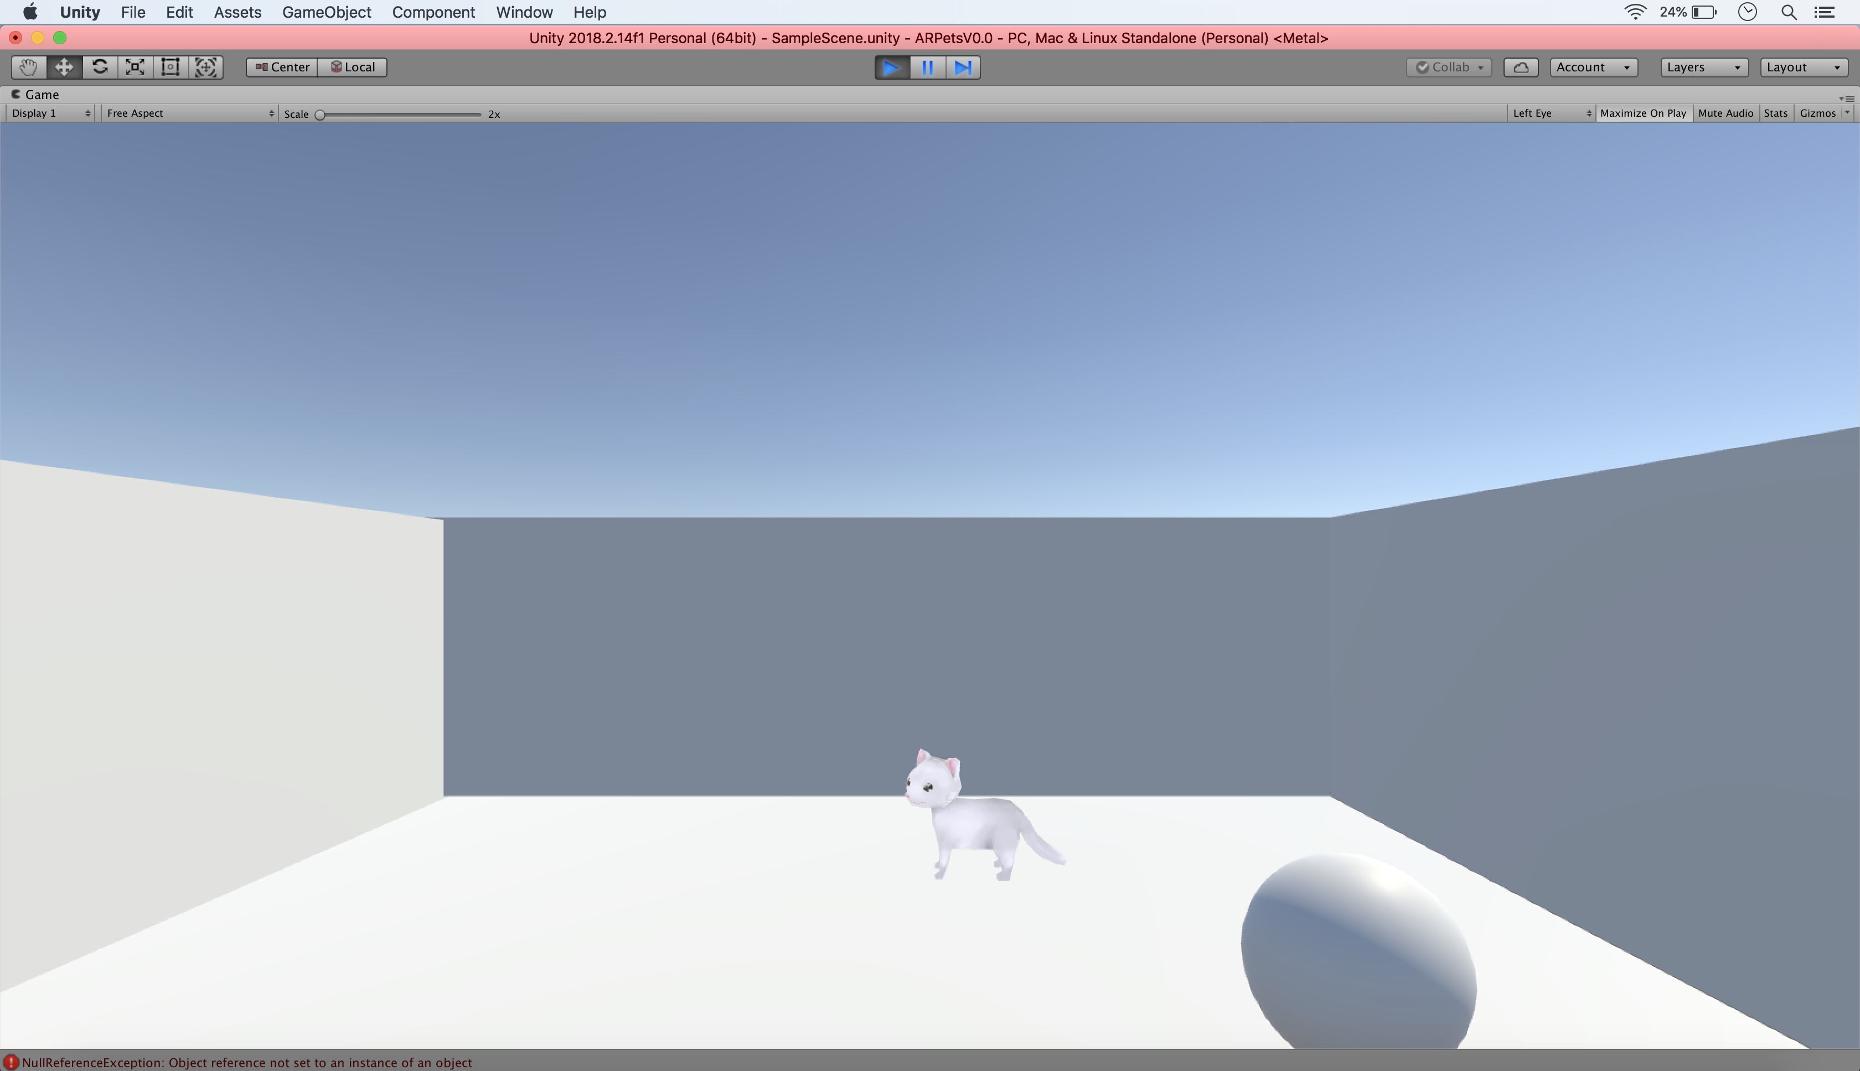
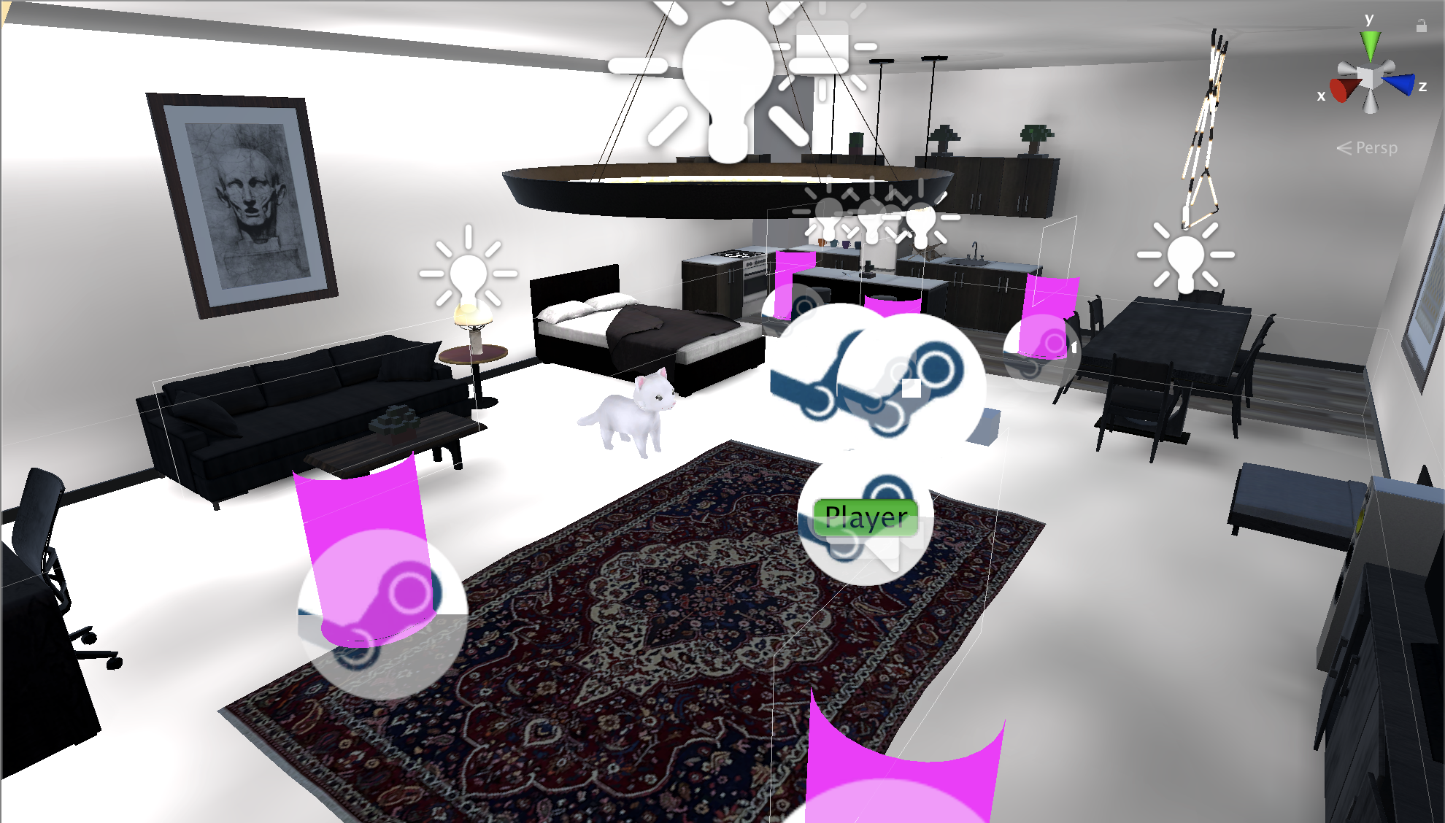
<- From This…
To this! ->

Slide 8
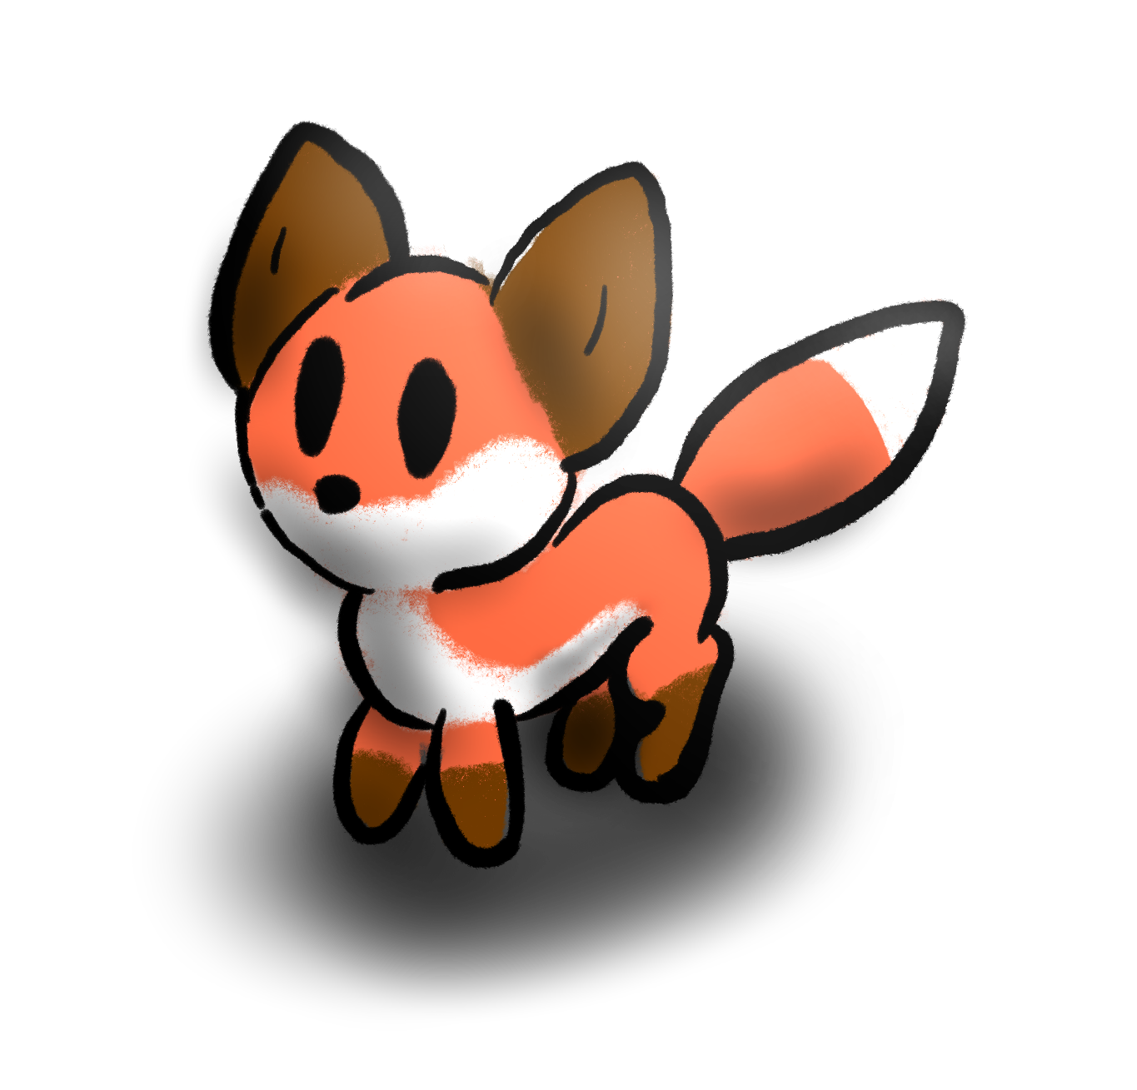
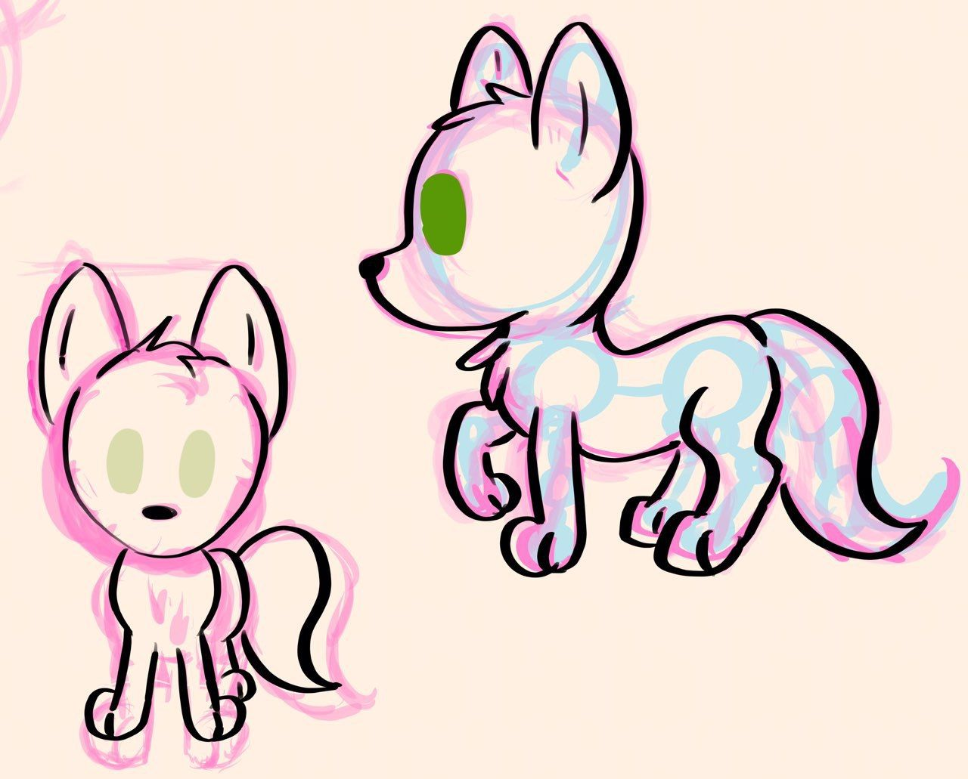
Model Work
Sketch, Modeling/Rigging in Blender
+
+
Started With Sketches and our default Cat Lite…
Off to Blender!
->

Slide 9
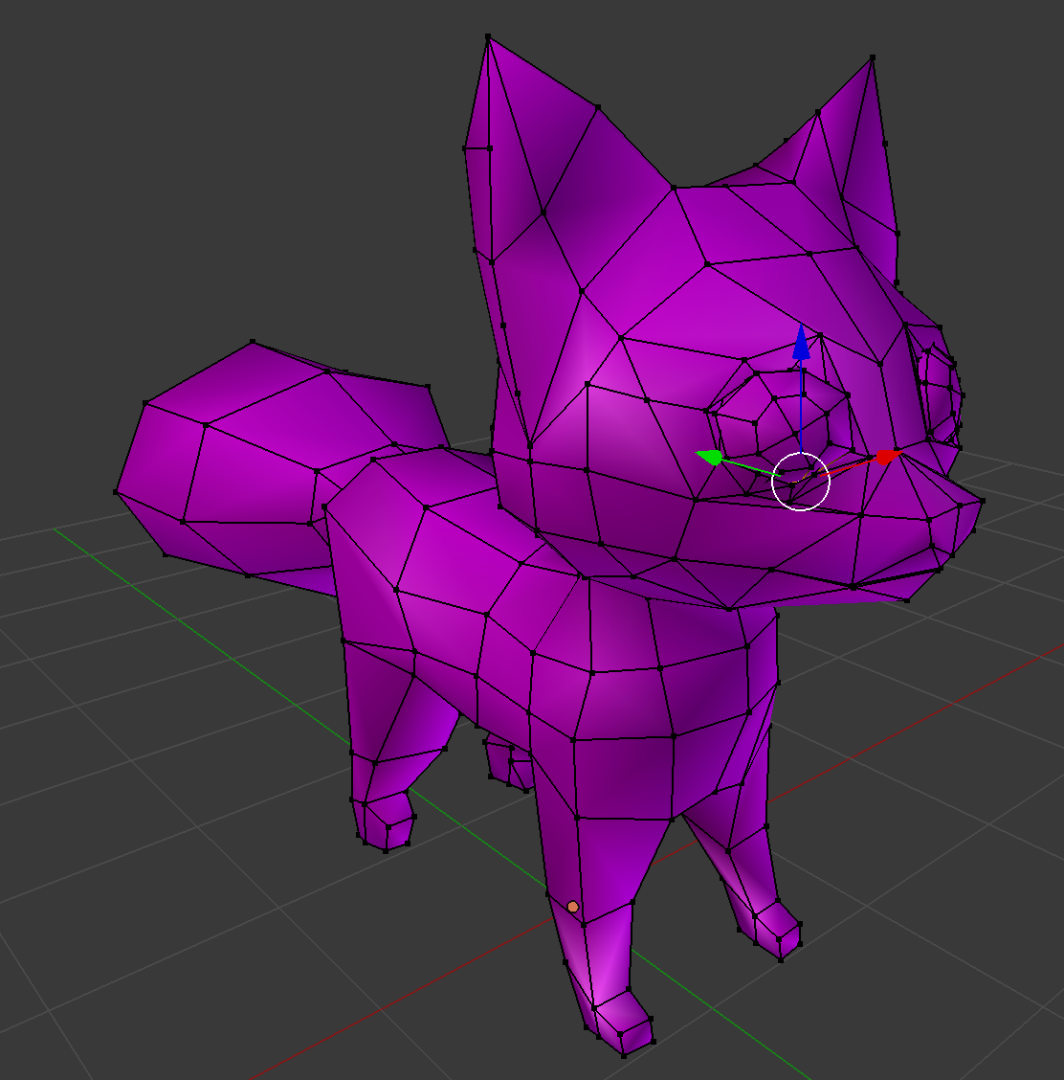
Basing everything on default cat:
Got to this:
What about color?
->

Slide 10
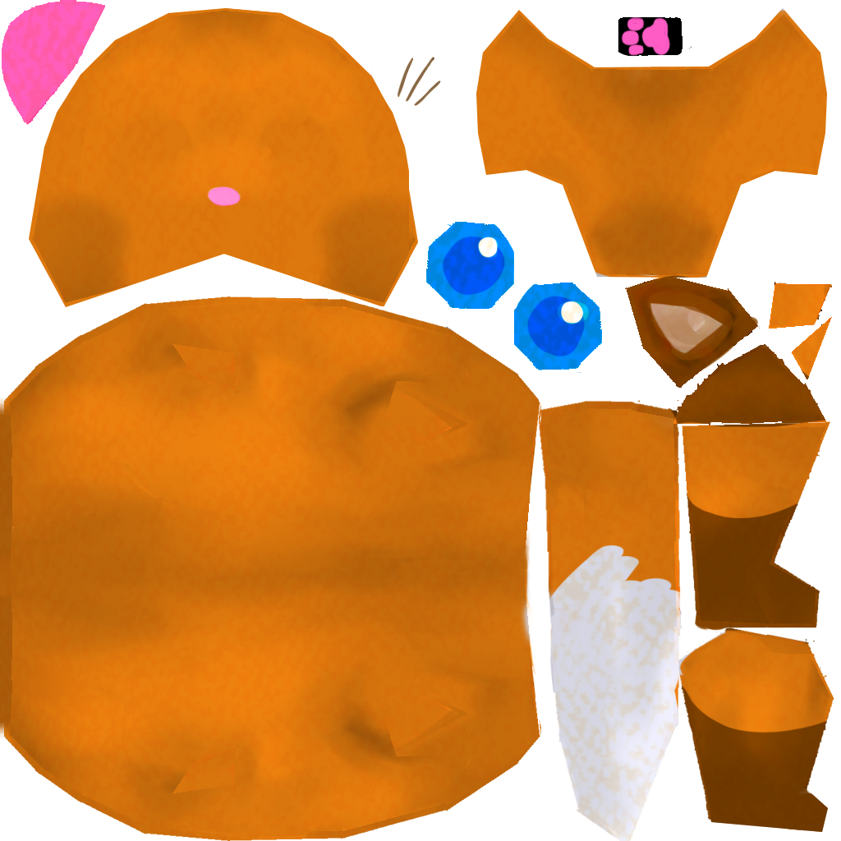
From doodle plus model…
Made a texture based on Cat Lite’s.
Applied it and…..???
+
???
+
->

Slide 11
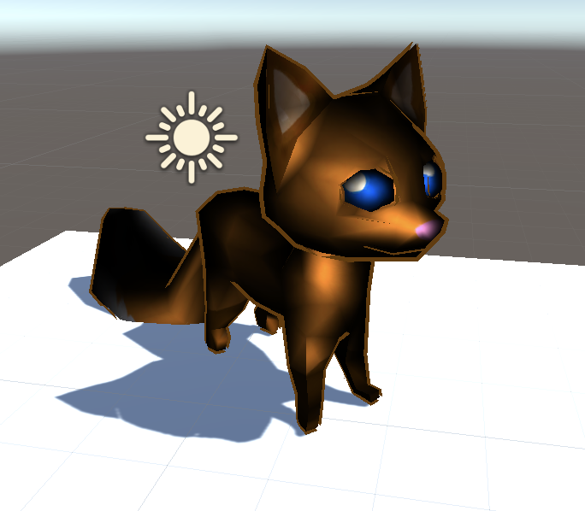
From doodle plus model…
Made a texture based on Cat Lite’s.
Applied it and…..???
+
+
->

Slide 12
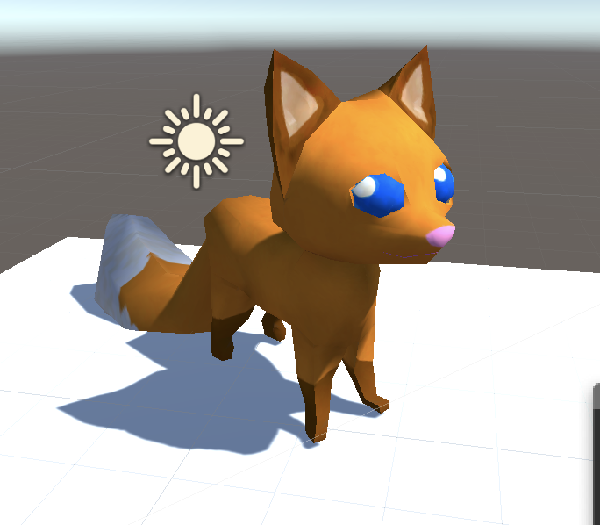
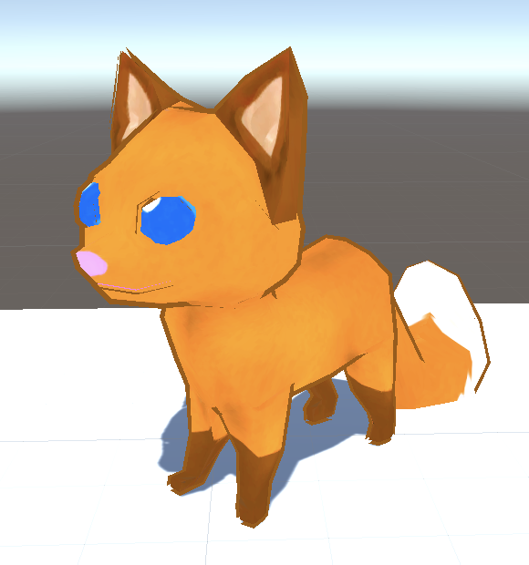
So I fixed the shader…
Decided to go with a toon shader after.
->

Slide 13
As for animations…
The cat lite Default animations:
Loaded onto Fox Model
(With difficulty)
->

Slide 14
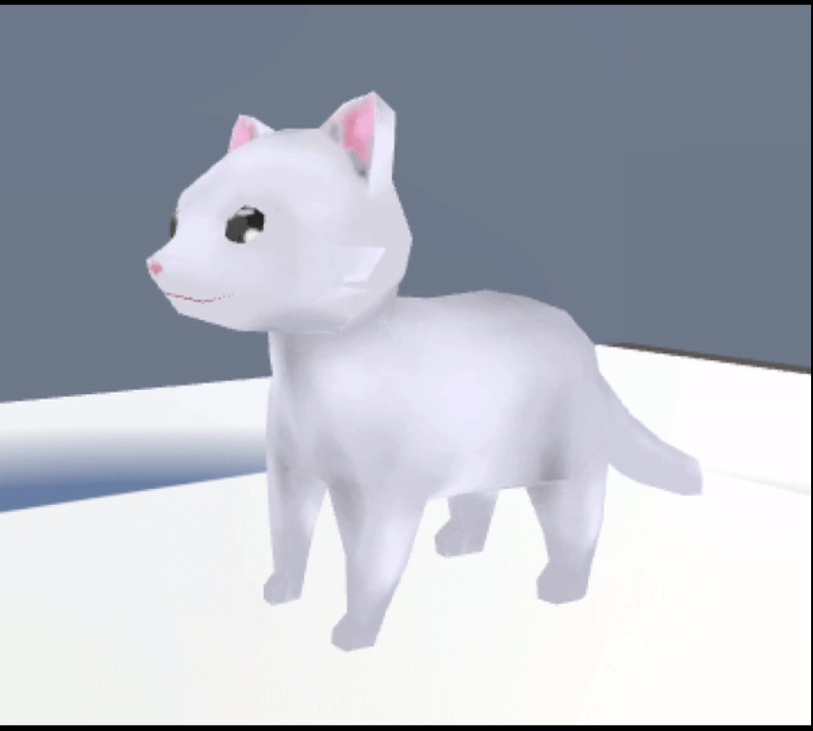
As for animations…
The cat lite Default animations:
Loaded onto Fox Model
(With difficulty)
->

Slide 15
Next?
Fix up Animations
Load Model into Main Project
Trigger Animations with Events
Make More Animations
At the end…
Tweak appearance
Refine
Finishing Touches

Slide 16
Thank you!
Demo Video?

